Slide 1
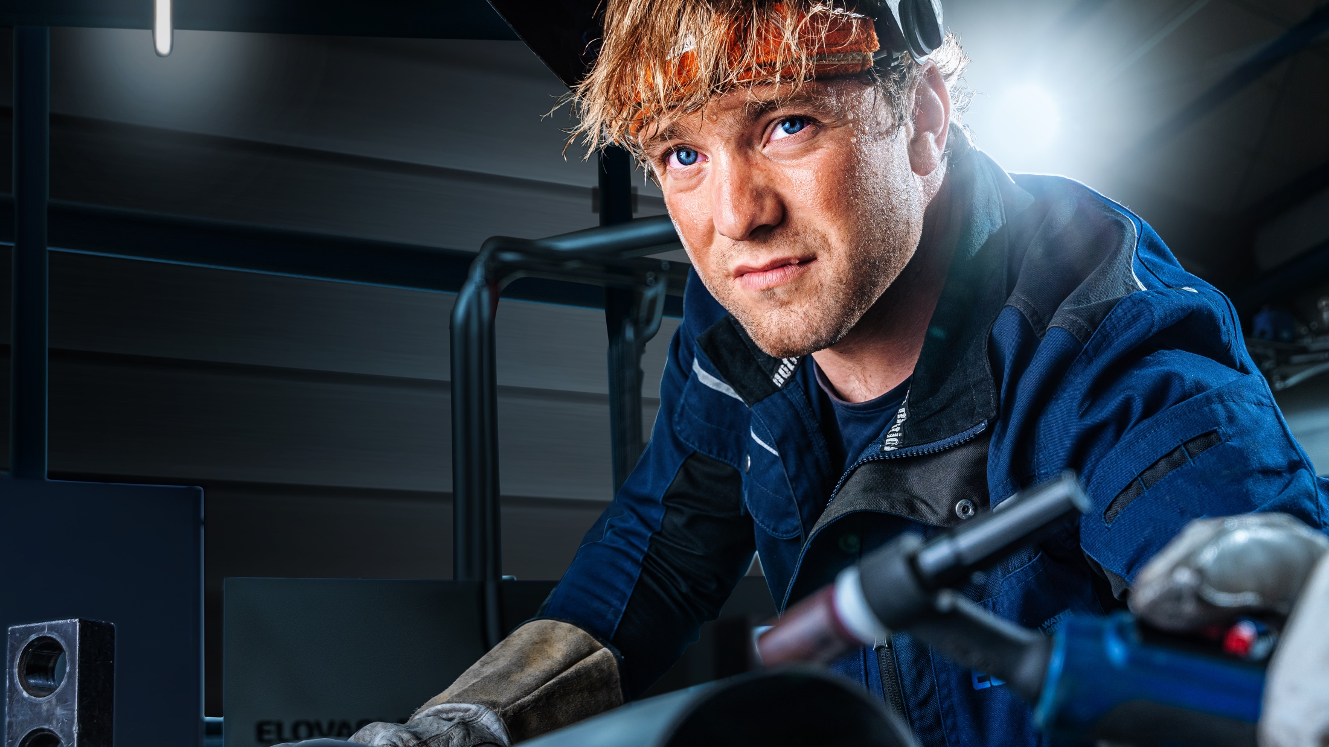
The essence of orbital welding
Mobile Welder - automated tube welding for everyone and everywhere!

Slide 2
STATUS QUO
What challenges are many
craft businesses facing in
the current situation?

Slide 3
SHORTAGE OF SKILLED LABOUR
The shortage of skilled labour is a problem for companies' productivity and competitiveness.

Slide 4
PHYSICAL STRAIN
The heavy physical labour has an impact on the health and well-being of employees.

Slide 5
TECHNOLOGICAL PROGRESS
New technologies influence the usual way of working and can quickly become overwhelming.

Slide 6
SUMMARISED
Welding tubes by hand can
be exhausting and
time-consuming.

Slide 7
OUR SOLUTION
With the Mobile Welder
you can now weld
completely automatically.

Slide 8
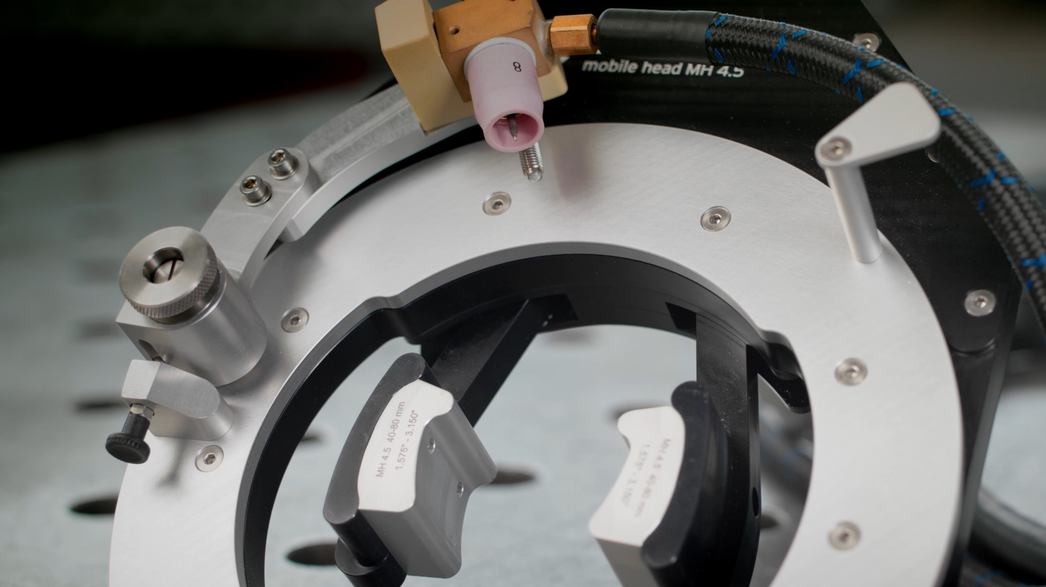
With the mechanised
TIG welding process...
23.11.2023
8

Slide 9
... an arc is automatically guided
around a fixed tube.
23.11.2023
9

Slide 10
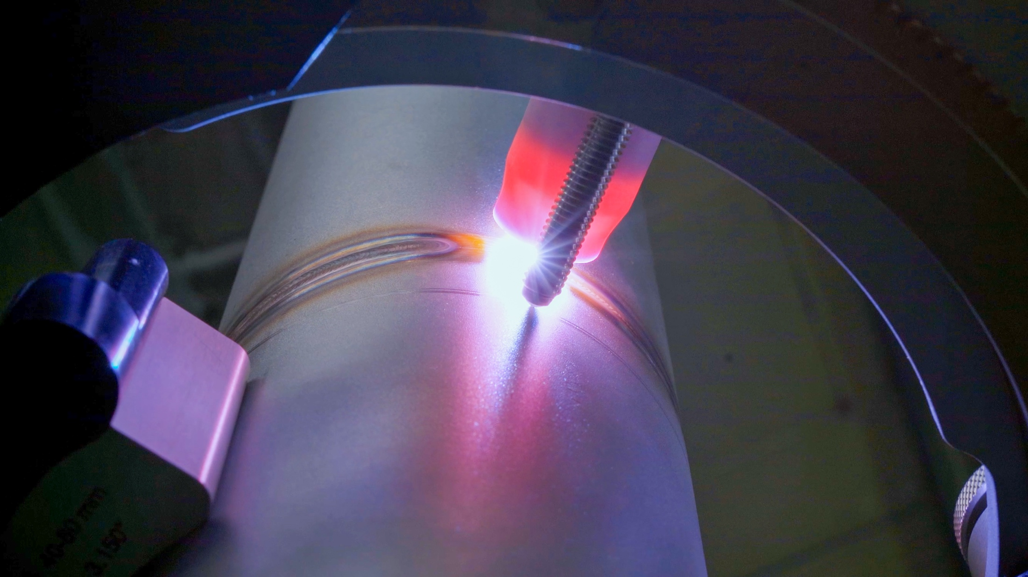
The result is a perfect
tube connection.
23.11.2023
10

Slide 11
Orbital welding has become
indispensable in many industries.
We will show you the advantages that you get from
modern orbital welding technology.

Slide 12





Das Orbitalschweißen ist in vielen
Branchen nicht mehr wegzudenken.
Wir zeigen dir die Vorteile, die Du durch die
moderne Orbitalschweißtechnik erhältst.
YOUR ADVANTAGES
High quality weld seams
Highly
repeatable
Effective time saving
Ergonomic
work
Easy
use

Slide 13
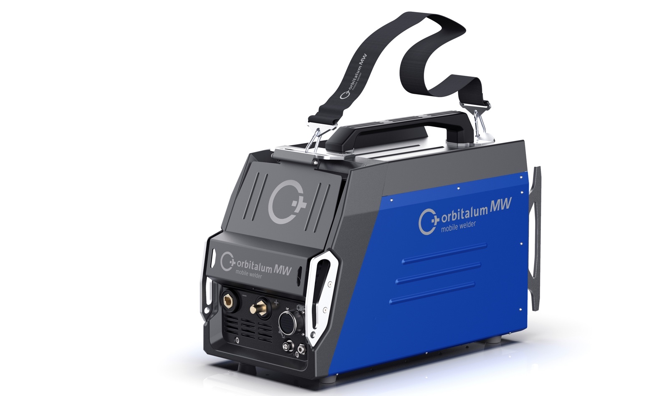
Mobile Welder
Your cost-effective introduction
to orbital welding.

Slide 14

MOBILE WELDER
Shoulder strap
Light and Robust –
Your physical relief
The Mobile Welder provides physical
relief during your daily work without
restricting your abilities.
Perfect for mobile use
Carrying handle and shoulder strap for easy carrying with one hand
Weight: approx. 15 kg
Carrying handle
Front cover
Impact protection elements

Slide 15
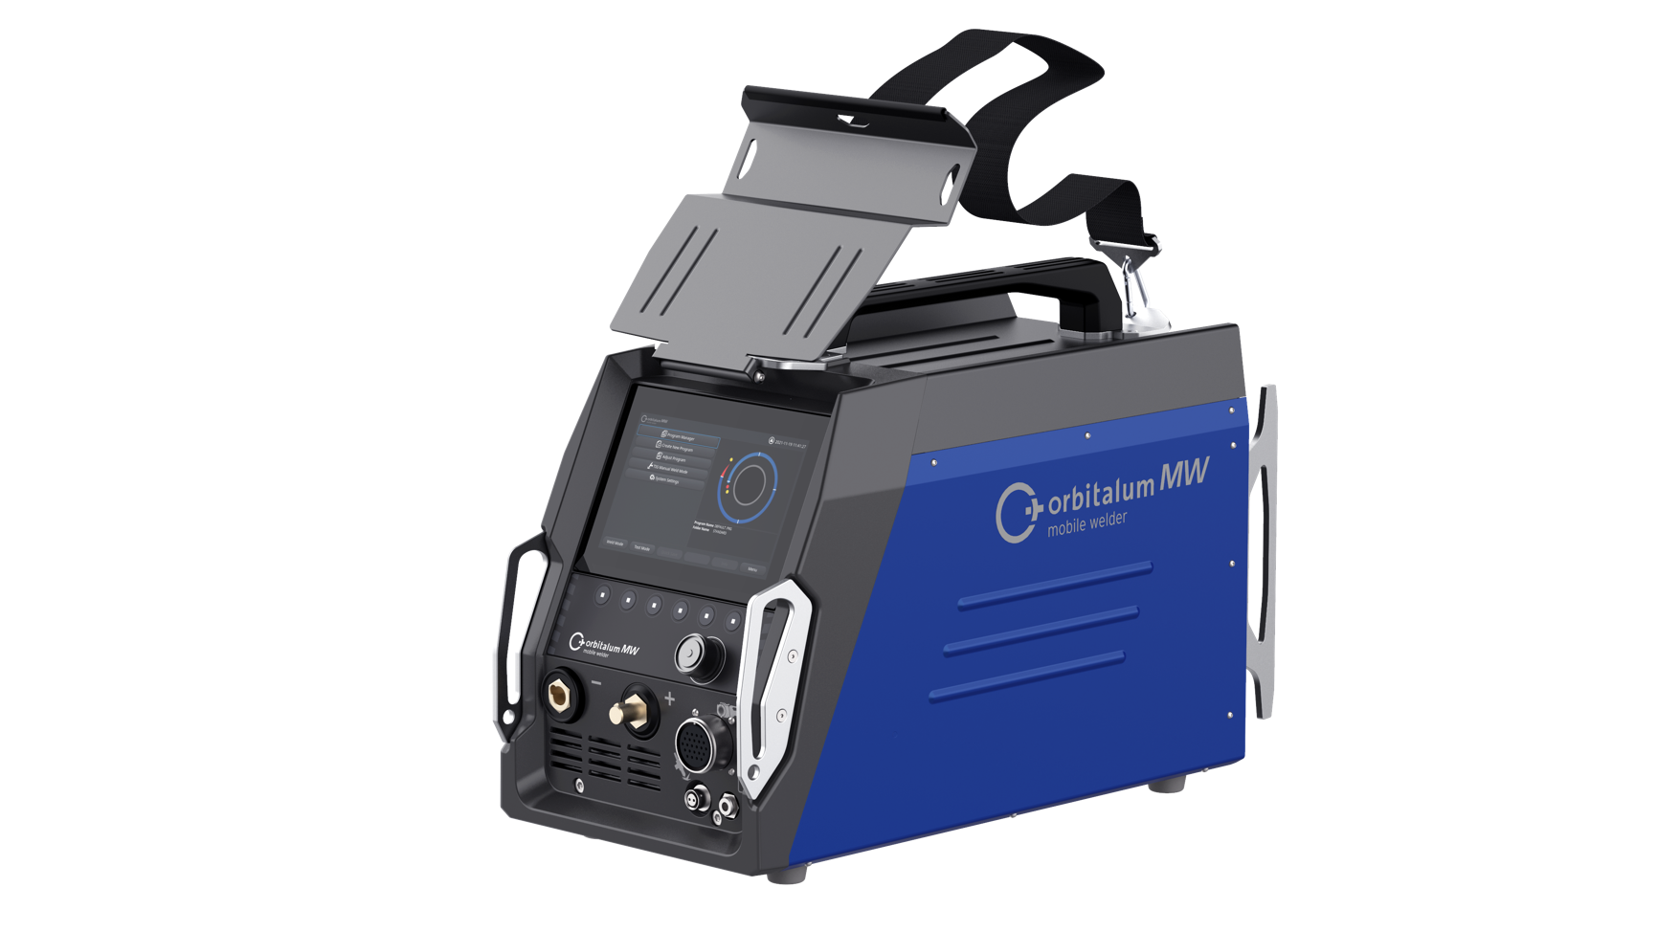
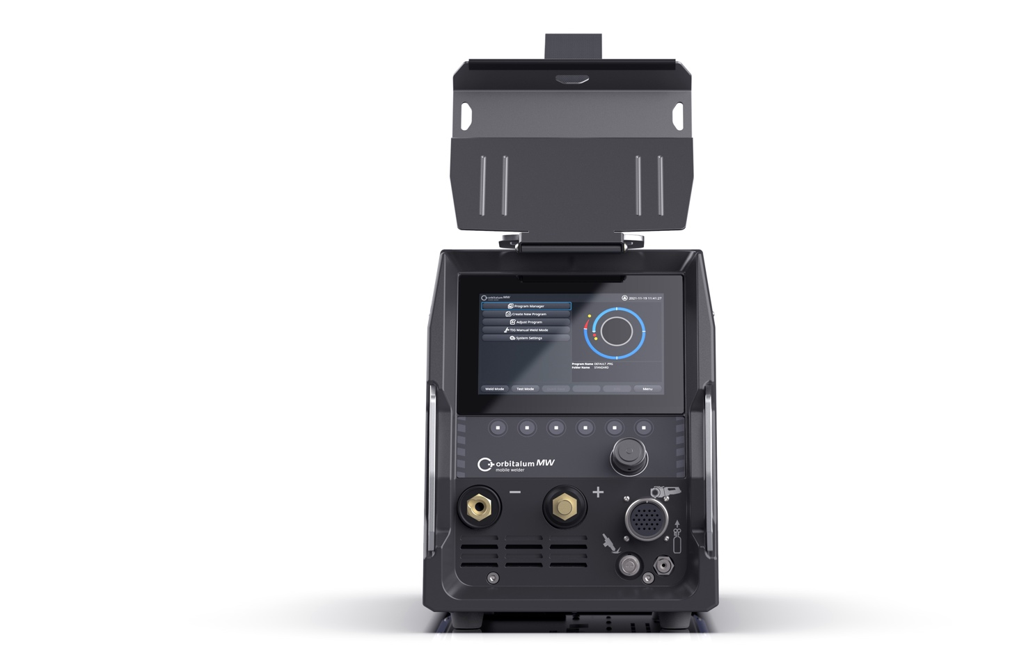
MOBILE WELDER
Simple Operation –
User-friendliness redefined
By focusing on the essential functions of orbital welding and deliberately reducing complexity,
workers can be trained very easily..
Operation via touch display or rotary knob
Intuitive menu design
Automatic creation of orbital welding
programs
Touch display
Auto programming
Rotary knob

Slide 16
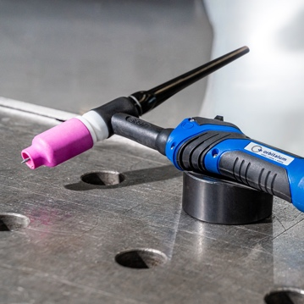
MOBILE WELDER
Manual or Orbital –
The best of both worlds
The Mobile Welder combines manual expertise with technological progress.
Switchable user interface between orbital and manual welding
Tacking work with TIG hand torch for thorough preparation of the tubes
Manual welded joints for hard-to-reach areas

Slide 17
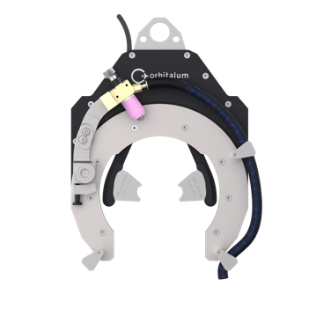
MOBILE WELDER
Ready to Weld-Package –
Your entry into orbital welding
With the Ready to Weld-Package, you get everything you need for orbital welding:
The Mobile Welder
The MH 4.5 Weld Head
All required connection lines
and hoses

Slide 18

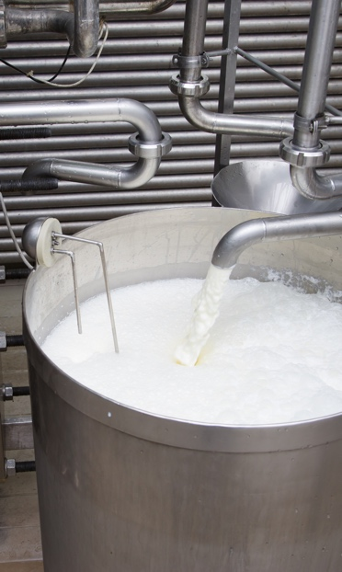
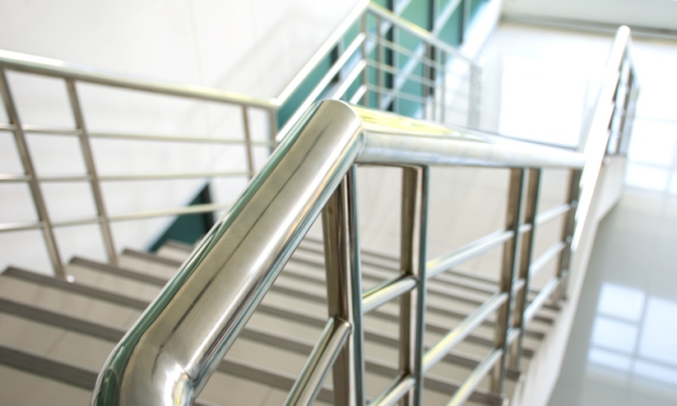
APPLICATION AREAS
02 Dairy • Establishment of piggable tube systems through high-quality weld seams
01 Brewery • flexible & efficient conversions and repairs, compliance with high hygiene standards
03 Railing construction • aesthetic demands, compliance with safety standards and consistent reproducibility

Slide 19
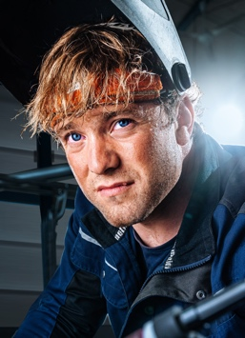
YOUR CONTACT PERSON
We are here for you - personal & committed.
I am at your disposal for questions and problems as well as to accompany you on your way to orbital welding. Please let me know how we can support you at any time.
Because your success is our goal!
First name Last name
Job title
Your telephone number
E-mail address
––
mobilewelder.com

Slide 20

Thank you very much.
Orbitalum Tools GmbH
Josef-Schuettler-Str. 17
78224 Singen
Germany
Tel.: +49 77 31 792-0
mobilewelder@orbitalum.com
www.mobilewelder.com
www.orbitalum.com

